Slide 1
Practical Data Science with Python
COSC 2670
Assignment 1 Part2
Notes:
This is the Practical data science Assignment1 Part2 task 1 oral presentation, for the next I will talk about how did I prepare my starwars data, how did I explore my data and what is the result from my anaylsis in assignemtn part1

Slide 2
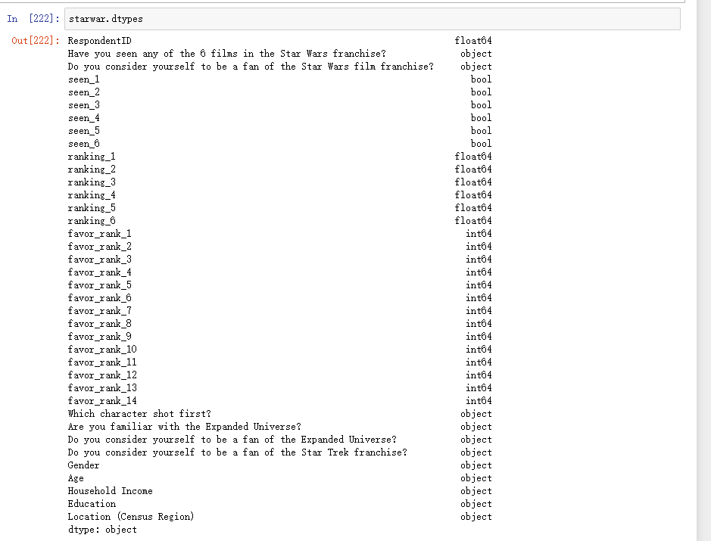
How to prepare the data?
The normal processing:
Data Retrieving
Check the data types
Notes:
so this is how did I prepare my data, its a normal way to clean data, by data retrieving, check the data type

Slide 3
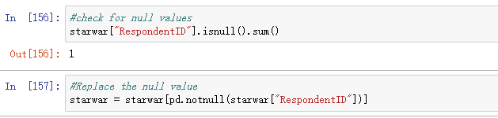
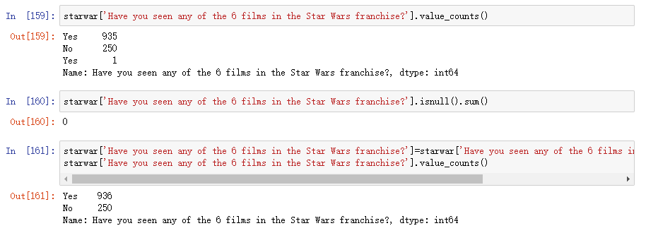
Clean the data
Notes:
normally I chek the null values first becuz its will influence my analysis

Slide 4
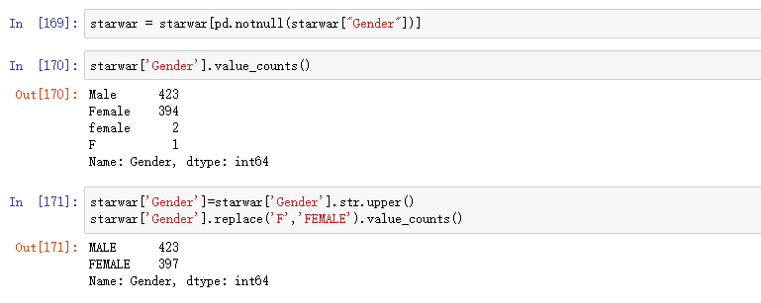
Notes:
and check the wrong data in this case, we can see there is 1F and 2 female start with lower case letter

Slide 5
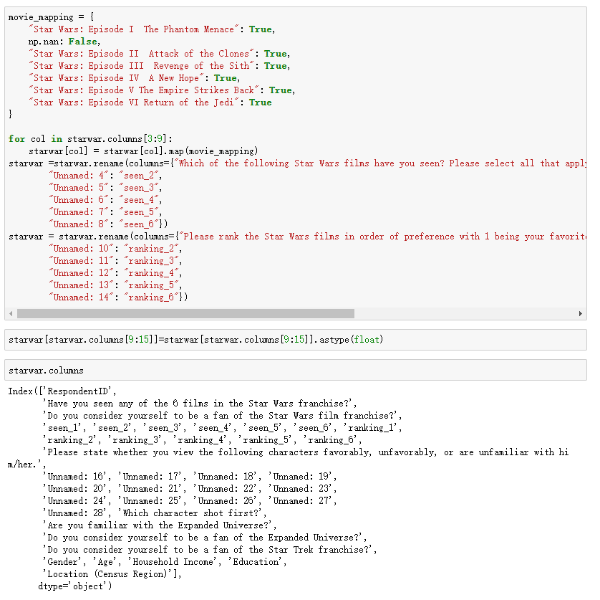
Notes:
however this one is different, becuz the starwars nameis on the second line in the dataset so we dont have the name so for the easier to visilation

Slide 6
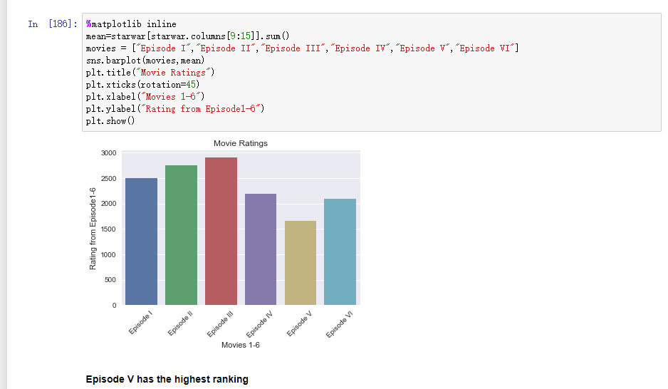
How to explore the data?
Task2.1
Notes:
For the ecplore data some of them I calculate the sum of data

Slide 7
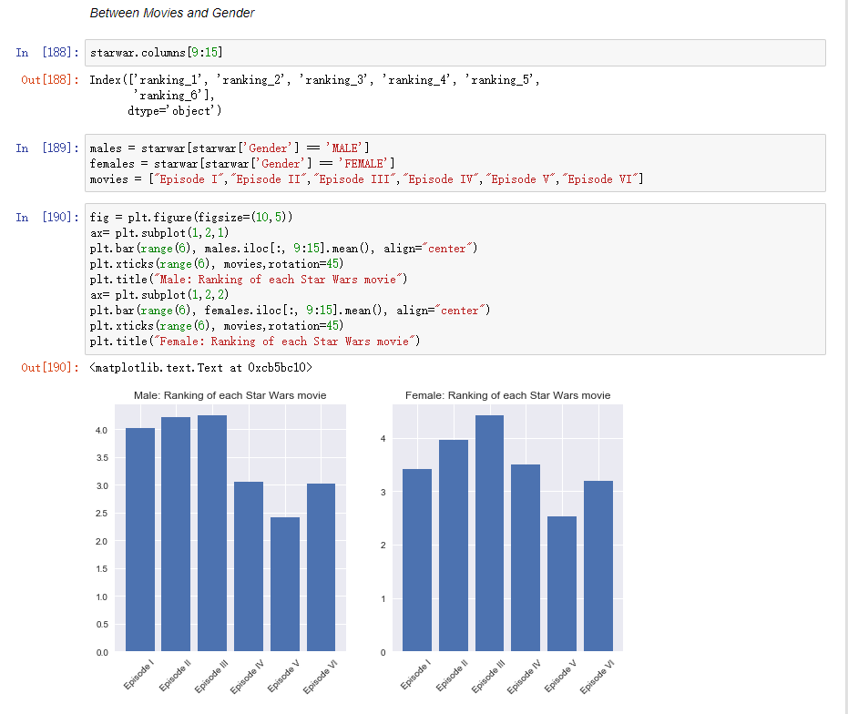
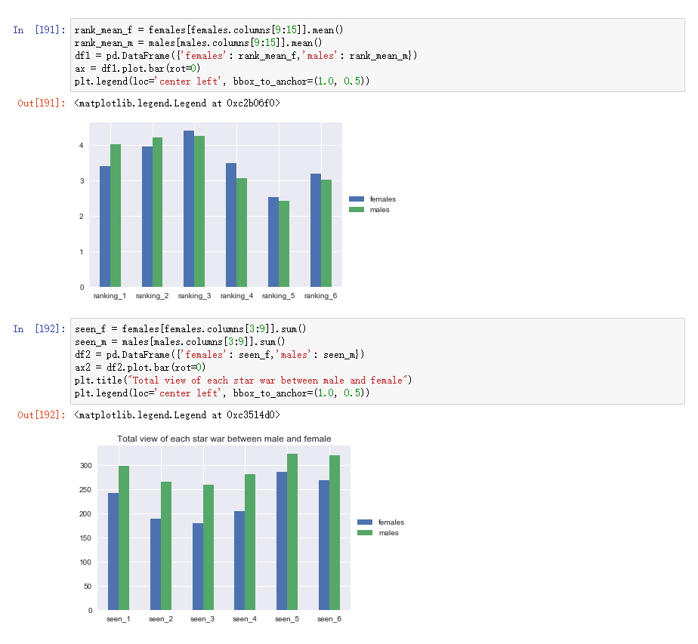
Relationships between columns
Notes:
some of them I calculate the mean value in those two cases I calculate the mean

Slide 8
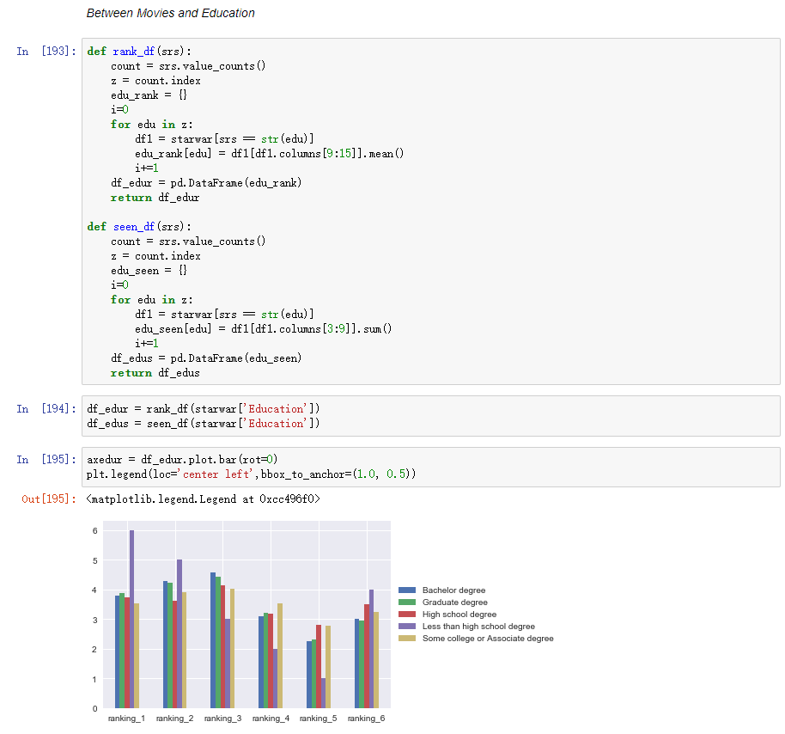
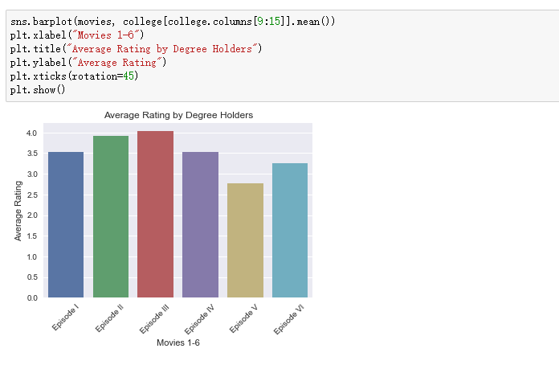
Relationships between columns
Notes:
as you see, in the relationship between movie and education I calculate the mean in the rank and sum in the seen

Slide 9
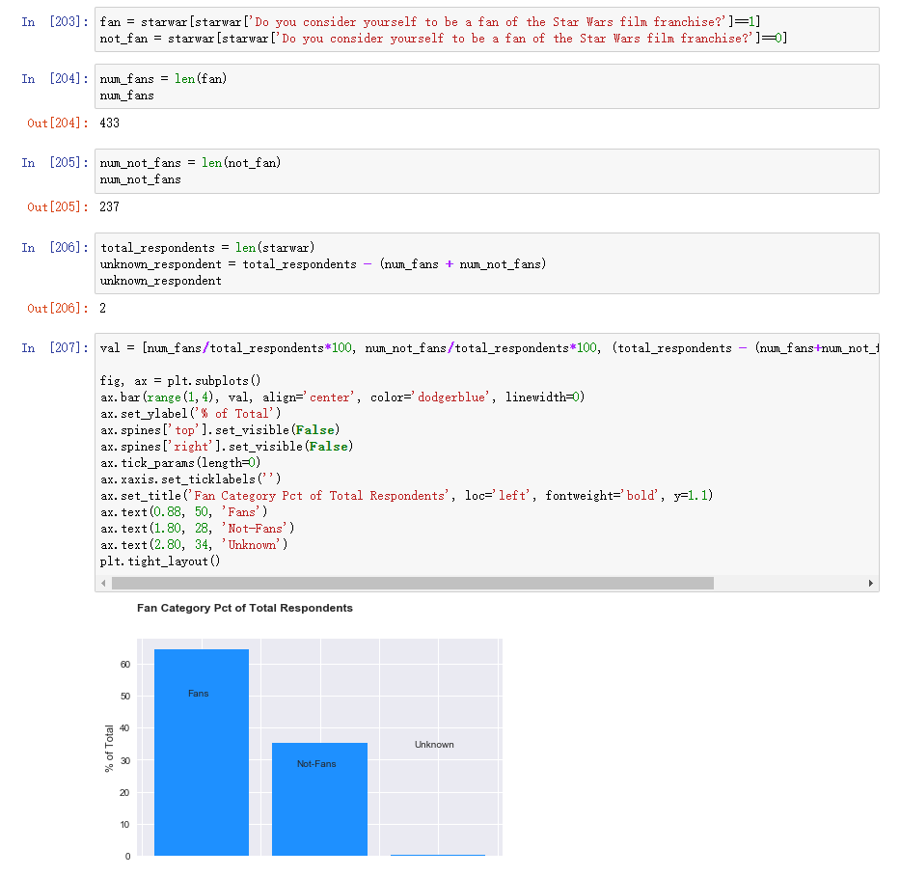
Relationships between columns
Notes:
in this case, fan category I used a algorithm which is num_fan/total *100 that we can calculate percent in fan, nonfan and unknown

Slide 10
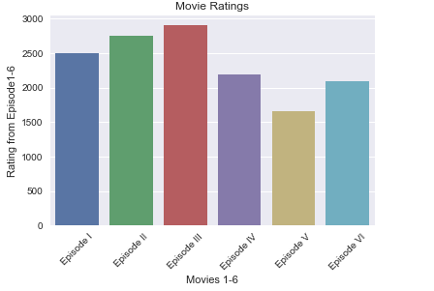
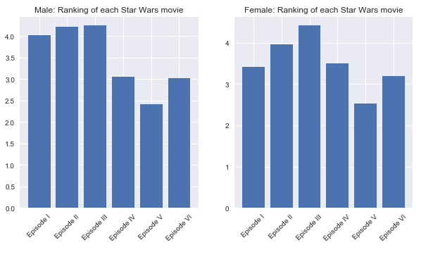
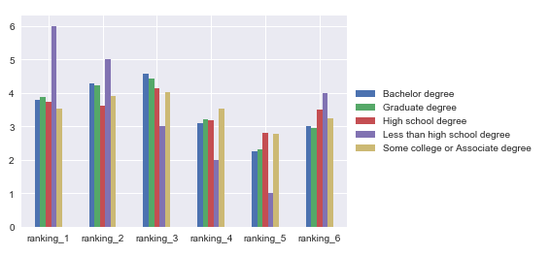
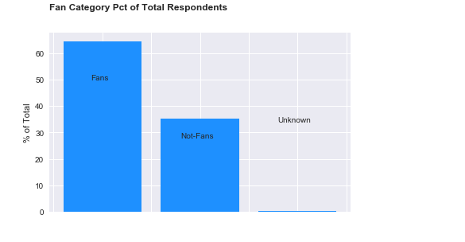
What are the results from your analysis?
Notes:
so this is waht the result, Episode5 is more popular, however the epiisode1 and 4have huge difference betweenn male and female and much more people who's degree is under the high school degree like the episode1 and more than 60%people is a fan of starwars

Slide 11
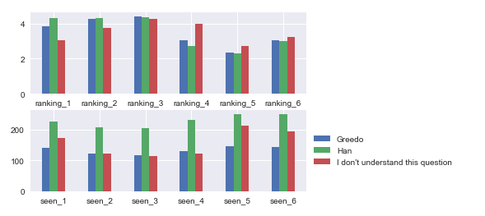
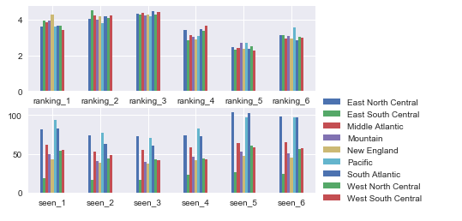
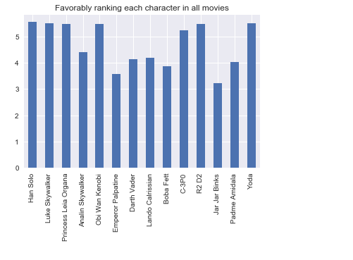
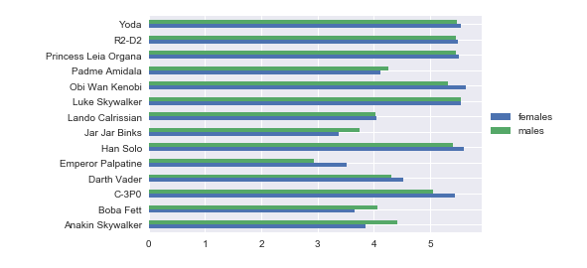
What are the results from your analysis?
Notes:
Seem like East North Central and pacific and sout atlantic watch a lot on Episode 1 4 5 6 and Emperor and Jar jar birike are the most dislike character.

Slide 12
Thanks

